Slide 1
Developing malicious kernel driverS
Friday, April 21, 2023
Parallels: go.tij.me/virtual-machine-parallels.pvmp OVF: go.tij.me/virtual-machine-ovf.zip
Notes:
You know what really grinds my gears? Having everything thought out for a red team action, and then be detected by modern EDR. Especially when simulating APTs and staying unobtrusive in the network for extended periods of time. Over the years we’ve moved from PowerShell one-liners to LOLBINS, from LOLBINS to C#-malware, and finally we've utilised direct syscalls. Somehow it still feels like modern EDR is chewing the scenery.
Kernel driver abuse is an existing but less known technique that offers opportunity to remain undetected, while infiltrating organisations for extended periods of time. For example, InvisiMole actively abuses BYOVD in the war in Ukraine. If you manage to load or exploit a kernel driver, nothing but relaxation awaits you, with a beer in your left hand and your C2 in your right. But loading or exploiting one poses several technical challenges, apart from all the knowledge required to work with kernel drivers. Obtaining that knowledge seems difficult. However, the road to kernel driver exploitation is not that long.
This talk is for those we’ve heard about the Windows Kernel and want to learn more about it. We’ll dive into the concepts of computer architecture, drivers, user and kernel mode, and kernel exploits. The best part is that you’ll learn to exploit and develop your first malicious kernel driver.

Slide 2
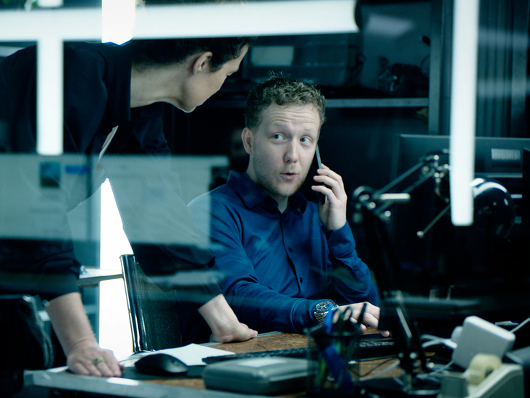
About
Tijme Gommers
Product Lead / Red Teamer
Works at Northwave Cyber Security
Forensics at Hunted (NPO3)
Lives in the Netherlands
Author of open-source software Kernel Mii, Raivo OTP, WikiRaider
Socials username is @tijme Twitter, GitHub, LinkedIn

Slide 3
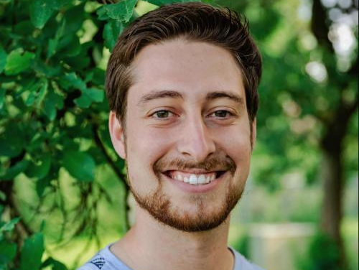
About
Jan-Jaap Korpershoek
Red Teamer / Reverse Engineer
Works at Northwave Cyber Security
Background in technical computer science
Lives in the Netherlands
Social media GitHub: @JJK96

Slide 4
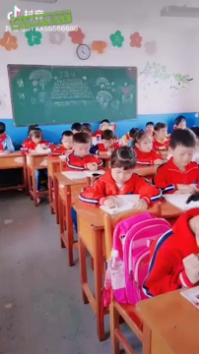





Index
Computer Architecture
Drivers
Kernel Malware
Development / Exploitation
CPU, memory, kernel mode & user mode
Hardware & software kernel drivers
A true attack, which we will also carry out
Becoming the APT
90 min

Slide 5

Computer Architecture 101
Offset | Value
0x82AD1000 | 0x00
0x82AD1001 | 0x00
0x82AD1002 | 0x00
0x82AD1003 | 0x00
0x82AD1004 | 0x00
0x82AD1005 | 0x00
0x82AD1006 | 0x00
0x82AD1007 | 0x00
0x82AD1008 | 0x00
0x82AD1009 | 0x00
0x82AD100A | 0x00
0x82AD100B | 0x00
0x82AD100C | 0x00
0x82AD100D | 0x00
Offset | Value
0x82AD1000 | 0x70
0x82AD1001 | 0x61
0x82AD1002 | 0x73
0x82AD1003 | 0x73
0x82AD1004 | 0x00
0x82AD1005 | 0x00
0x82AD1006 | 0x00
0x82AD1007 | 0x00
0x82AD1008 | 0x00
0x82AD1009 | 0x00
0x82AD100A | 0x00
0x82AD100B | 0x00
0x82AD100C | 0x00
0x82AD100D | 0x00
Virtual memory
lsass.exe
int
4 bytes
Virtual Memory
mov rax, [rax]
rax contains address of some LSASS credential

Slide 6
Computer Architecture 101
Offset | Value
0x82AD1000 | 0x00
0x82AD1001 | 0x00
0x82AD1002 | 0x00
0x82AD1003 | 0x00
0x82AD1004 | 0x00
0x82AD1005 | 0x00
0x82AD1006 | 0x00
0x82AD1007 | 0x00
0x82AD1008 | 0x00
0x82AD1009 | 0x00
0x82AD100A | 0x00
0x82AD100B | 0x00
0x82AD100C | 0x00
0x82AD100D | 0x00
Offset | Value
0x82AD1000 | 0x00
0x82AD1001 | 0x00
0x82AD1002 | 0x00
0x82AD1003 | 0x00
0x82AD1004 | 0x00
0x82AD1005 | 0x00
0x82AD1006 | 0x00
0x82AD1007 | 0x00
0x82AD1008 | 0x00
0x82AD1009 | 0x00
0x82AD100A | 0x00
0x82AD100B | 0x00
0x82AD100C | 0x00
0x82AD100D | 0x00
Virtual memory
my_malware.exe
int
4 bytes
Virtual Memory
mov rax, [rax]
rax contains address of some LSASS credential

Slide 7
Computer Architecture 101
Offset | Value
0x82AD1000 | 0x00
0x82AD1001 | 0x00
0x82AD1002 | 0x00
0x82AD1003 | 0x00
0x82AD1004 | 0x00
0x82AD1005 | 0x00
0x82AD1006 | 0x00
0x82AD1007 | 0x00
0x82AD1008 | 0x00
0x82AD1009 | 0x00
0x82AD100A | 0x00
0x82AD100B | 0x00
0x82AD100C | 0x00
0x82AD100D | 0x00
Physical memory
lsass.exe
Offset | Value
0x82AD1000 | 0x70
0x82AD1001 | 0x61
0x82AD1002 | 0x73
0x82AD1003 | 0x73
0x82AD1004 | 0x00
0x82AD1005 | 0x00
0x82AD1006 | 0x00
0x82AD1007 | 0x00
0x82AD1008 | 0x00
0x82AD1009 | 0x00
0x82AD100A | 0x00
0x82AD100B | 0x00
0x82AD100C | 0x00
0x82AD100D | 0x00
Physical offset | Value
0x11AF0000 | 0x00
0x11AF0001 | 0x00
0x11AF0002 | 0x70
0x11AF0003 | 0x61
0x11AF0004 | 0x73
0x11AF0005 | 0x73
0x11AF0006 | 0x00
0x11AF0007 | 0x00
0x11AF0008 | 0x00
0x11AF0009 | 0x00
0x11AF000A | 0x00
0x11AF000B | 0x00
0x82AD100C | 0x00
0x82AD100D | 0x00
int
4 bytes
Virtual Memory
mov rax, [rax]
rax contains address of some LSASS credential
7

Slide 8
Computer Architecture 101
Offset | Value
0x82AD1000 | 0x00
0x82AD1001 | 0x00
0x82AD1002 | 0x00
0x82AD1003 | 0x00
0x82AD1004 | 0x00
0x82AD1005 | 0x00
0x82AD1006 | 0x00
0x82AD1007 | 0x00
0x82AD1008 | 0x00
0x82AD1009 | 0x00
0x82AD100A | 0x00
0x82AD100B | 0x00
0x82AD100C | 0x00
0x82AD100D | 0x00
Physical memory
my_malware.exe
Offset | Value
0x82AD1000 | 0x00
0x82AD1001 | 0x00
0x82AD1002 | 0x00
0x82AD1003 | 0x00
0x82AD1004 | 0x00
0x82AD1005 | 0x00
0x82AD1006 | 0x00
0x82AD1007 | 0x00
0x82AD1008 | 0x00
0x82AD1009 | 0x00
0x82AD100A | 0x00
0x82AD100B | 0x00
0x82AD100C | 0x00
0x82AD100D | 0x00
Physical offset | Value
0x11AF0000 | 0x00
0x11AF0001 | 0x00
0x11AF0002 | 0x70
0x11AF0003 | 0x61
0x11AF0004 | 0x73
0x11AF0005 | 0x73
0x11AF0006 | 0x00
0x11AF0007 | 0x00
0x11AF0008 | 0x00
0x11AF0009 | 0x00
0x11AF000A | 0x00
0x11AF000B | 0x00
0x82AD100C | 0x00
0x82AD100D | 0x00
int
4 bytes
Virtual Memory
mov rax, [rax]
rax contains address of some LSASS credential
8

Slide 9
Computer Architecture 101
Windows Memory Mapping
Runs in kernel mode
Offset | Value
0x82AD1000 | 0x00
0x82AD1001 | 0x00
0x82AD1002 | 0x00
0x82AD1003 | 0x00
0x82AD1004 | 0x00
0x82AD1005 | 0x00
0x82AD1006 | 0x00
0x82AD1007 | 0x00
0x82AD1008 | 0x00
0x82AD1009 | 0x00
0x82AD100A | 0x00
0x82AD100B | 0x00
0x82AD100C | 0x00
0x82AD100D | 0x00
Physical memory
lsass.exe
my_malware.exe
Offset | Value
0x82AD1000 | 0x00
0x82AD1001 | 0x00
0x82AD1002 | 0x00
0x82AD1003 | 0x00
0x82AD1004 | 0x00
0x82AD1005 | 0x00
0x82AD1006 | 0x00
0x82AD1007 | 0x00
0x82AD1008 | 0x00
0x82AD1009 | 0x00
0x82AD100A | 0x00
0x82AD100B | 0x00
0x82AD100C | 0x00
0x82AD100D | 0x00
Physical offset | Value
0x11AF0000 | 0x00
0x11AF0001 | 0x00
0x11AF0002 | 0x70
0x11AF0003 | 0x61
0x11AF0004 | 0x73
0x11AF0005 | 0x73
0x11AF0006 | 0x00
0x11AF0007 | 0x00
0x11AF0008 | 0x00
0x11AF0009 | 0x00
0x11AF000A | 0x00
0x11AF000B | 0x00
0x82AD100C | 0x00
0x82AD100D | 0x00
int
4 bytes
Virtual Memory
mov rax, [rax]
rax contains address of some LSASS credential
9

Slide 10



Computer Architecture 101
Computer memory
User mode to kernel mode
mimikatz

Slide 11
Computer Architecture 101
Computer memory
User mode to kernel mode
KERNEL32.dll OpenProcess
mimikatz

Slide 12
Computer Architecture 101
Computer memory
User mode to kernel mode
KERNEL32.dll OpenProcess
mimikatz
NTDLL.dll NtOpenProcess

Slide 13
Computer Architecture 101
Computer memory
User mode to kernel mode
KERNEL32.dll OpenProcess
mimikatz
NTDLL.dll NtOpenProcess
Syscall table
Syscall table
USER MODE
KERNEL MODE

Slide 14
Computer Architecture 101
Computer memory
User mode to kernel mode
KERNEL32.dll OpenProcess
mimikatz
NTDLL.dll NtOpenProcess
Syscall table
Syscall table
NtOsKrnl.exe NtOpenProcess
USER MODE
KERNEL MODE

Slide 15
Computer Architecture 101
Computer memory
User mode to kernel mode
KERNEL32.dll OpenProcess
mimikatz
NTDLL.dll NtOpenProcess
Syscall table
KERNEL32.dll ReadProcessMemory
…
NtOsKrnl.exe NtOpenProcess
USER MODE
KERNEL MODE

Slide 16

Computer Architecture 101
Computer memory
User mode to kernel mode
KERNEL32.dll OpenProcess
mimikatz
Administrative rights? Process is not protected?
NTDLL.dll NtOpenProcess
Syscall table
KERNEL32.dll ReadProcessMemory
…
NtOsKrnl.exe NtOpenProcess
USER MODE
KERNEL MODE

Slide 17
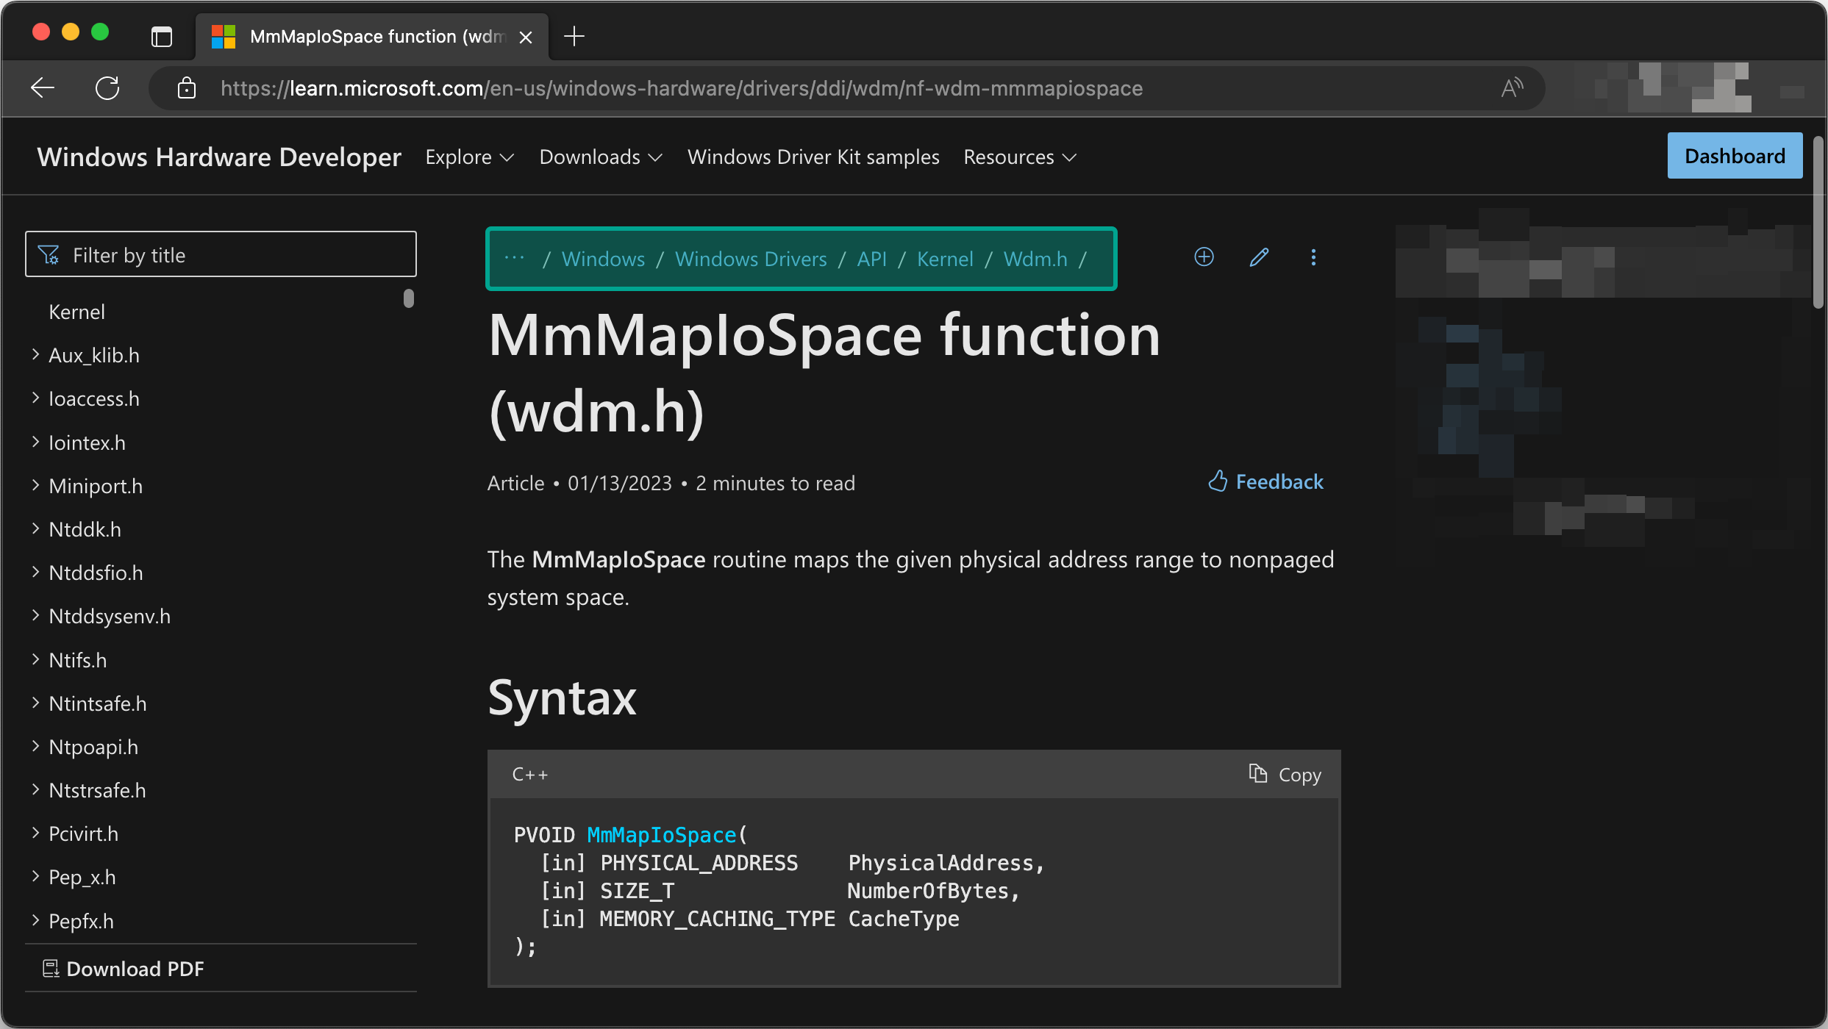
Computer Architecture 101
User mode to kernel mode

Slide 18
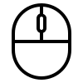





Drivers 101
Hardware drivers
Peripherals
Computer
User
KERNEL DRIVER
KERNEL DRIVER

Slide 19
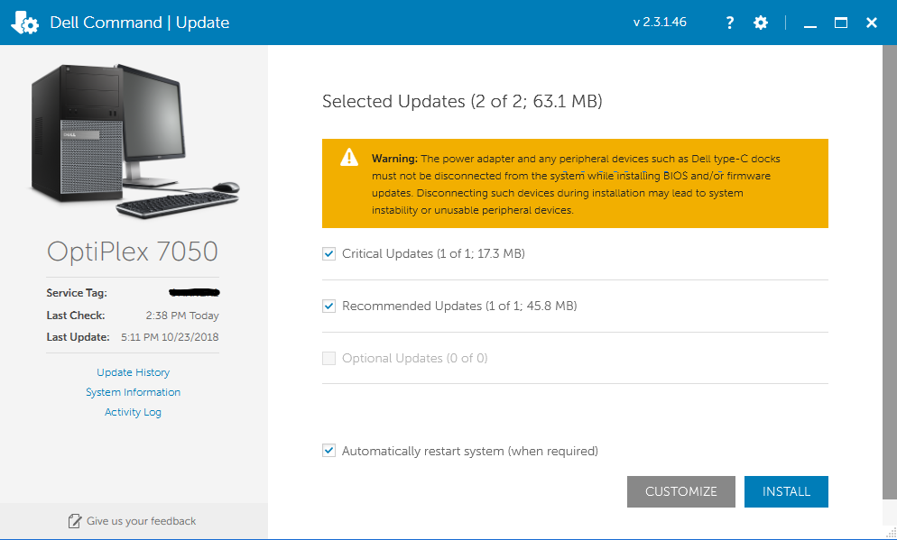

Drivers 101
Software drivers
Firmware update utility
Computer
User
KERNEL DRIVER

Slide 20
Drivers 101
Input/output control codes (IOCTL’s)
Firmware update utility
Computer
Input/output control code (IOCTL) 0x8000400C: Read firmware status
KERNEL DRIVER
Input/output control code (IOCTL) 0x8000500D: Update firmware to given binary
Note: These IOCTLs are fictional

Slide 21
Drivers 101
Input/output control codes (IOCTL’s)
Firmware update utility
Input/output control code (IOCTL) 0x8000500D: Update firmware to given binary
char * data = ...;
size_t size = 0x1000;
HANDLE handle = CreateFile("\\\\.\\dbutil_2_3", ...)
DeviceIoControl(handle, 0x8000500D, data, size, ...)
Computer
KERNEL DRIVER
Note: This example is fictional

Slide 22
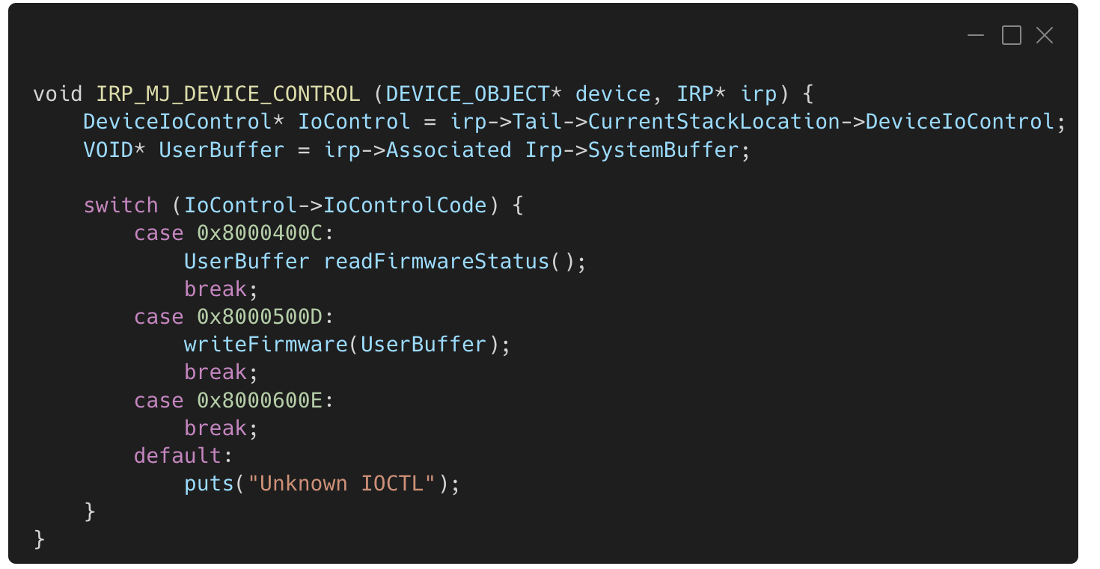
Drivers 101
Switch statement of supported IOCTL’s in driver source code
When someone calls DeviceIoControl(…)
KERNEL DRIVER
Note: These IOCTLs are fictional

Slide 23
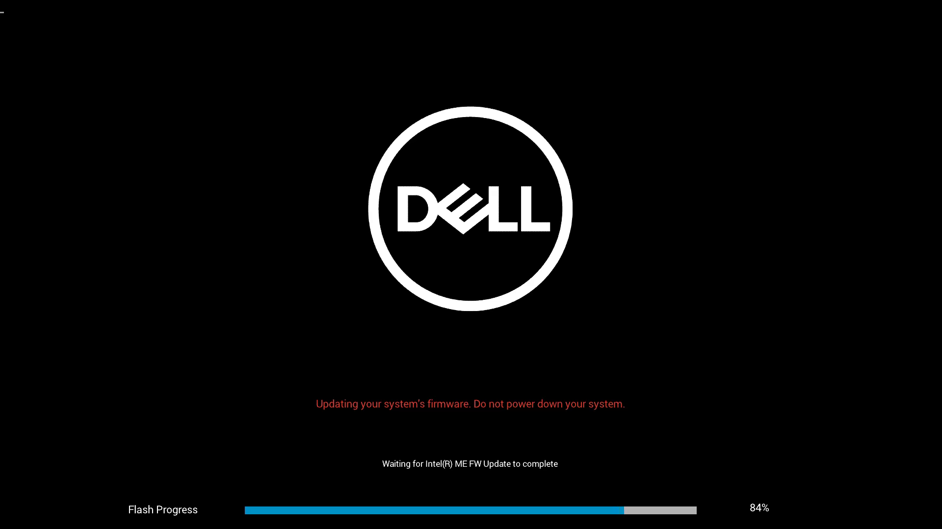

Slide 24

Drivers 101
Installation
Driver signing useful for threat actors, but probably not for red teams.
In this lab we’ll exploit an existing driver instead! dbutil_2_3.sys

Slide 25








A true attack (2021)
Research by
Lazarus
Computer of an aerospace company in the Netherlands
Phishing operations
Phishing message
Malware
C&C

Slide 26


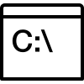
A true attack (2021)
Research by
Lazarus
Computer of an aerospace company in the Netherlands
Phishing operations
Phishing message
Malware
C&C
dbutil_ 2_3.sys
Install vulnerable driver & disable defensive measurements

Slide 27
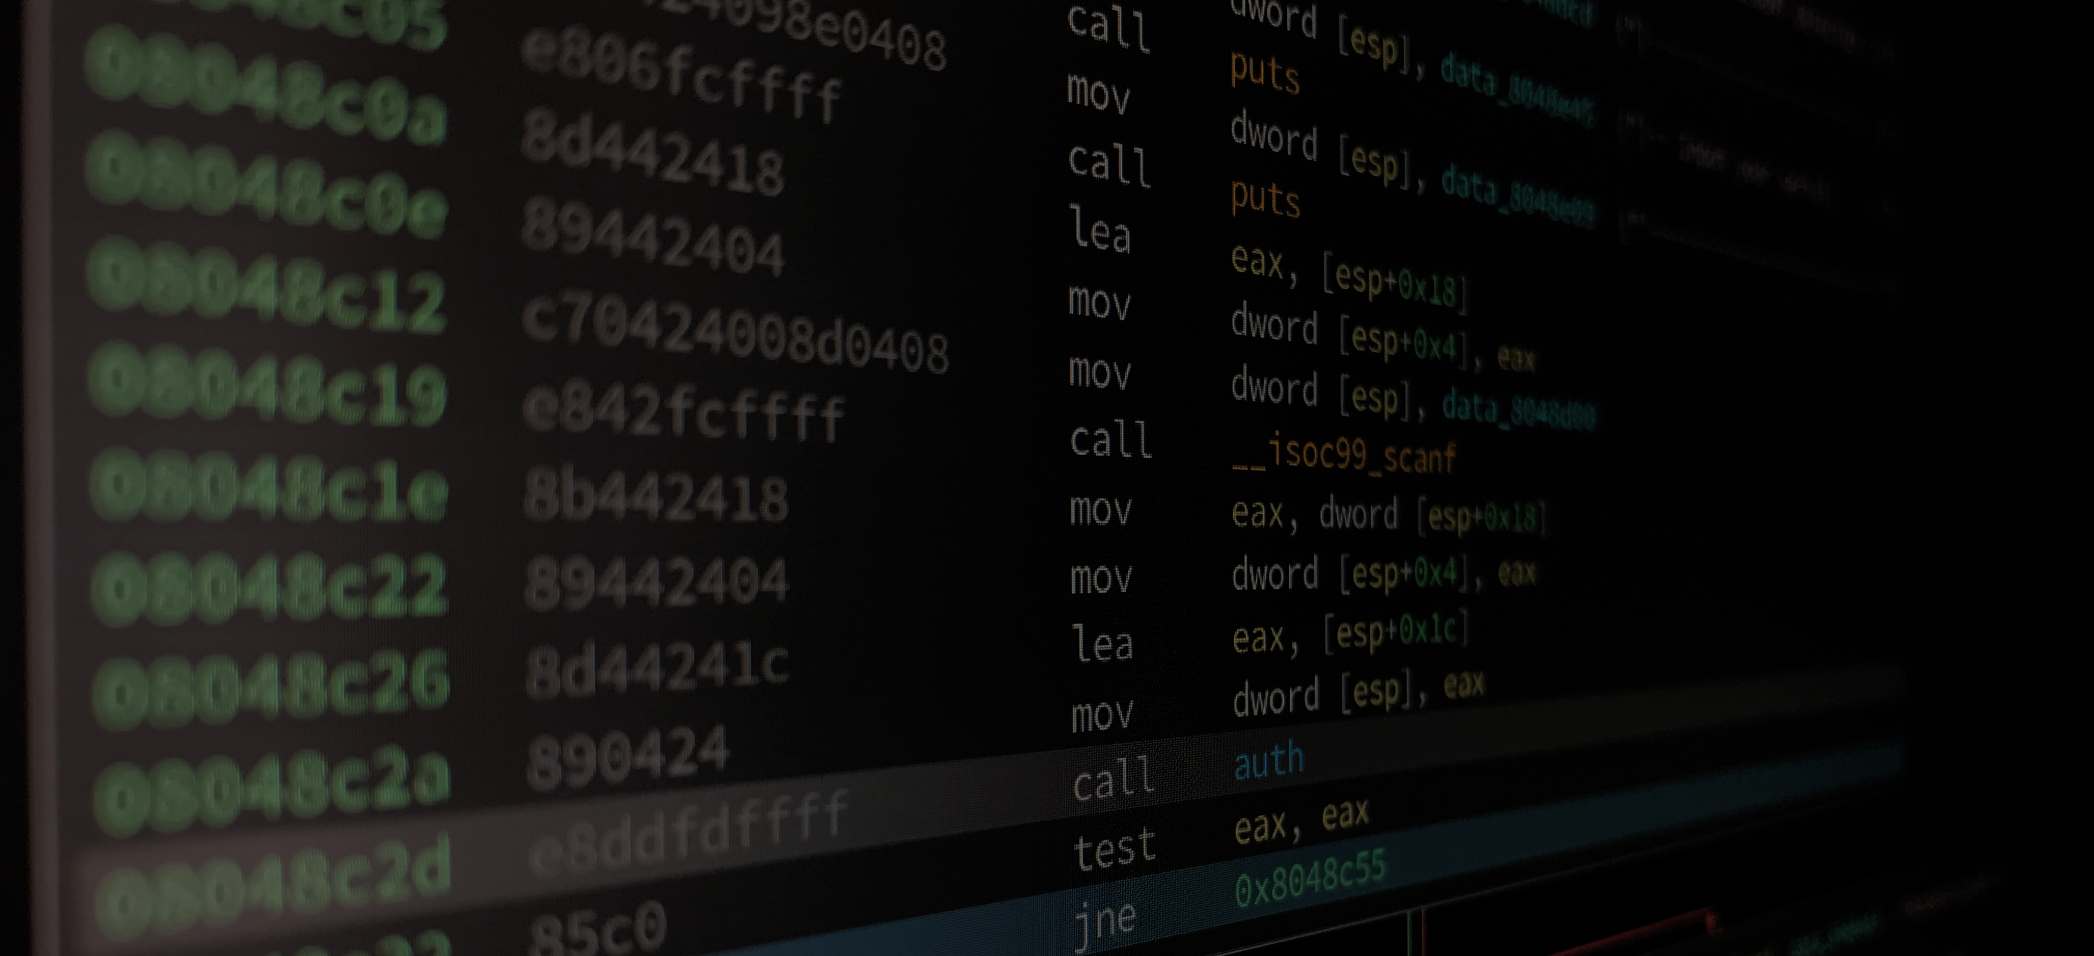
Reversing kernel driver demo
EXERCISES
Download the exercise files at https://go.tij.me/exercise1-good-luck.zip, easy mode cheat sheet at https://go.tij.me/exercise-cheatsheet.pdf

Slide 28
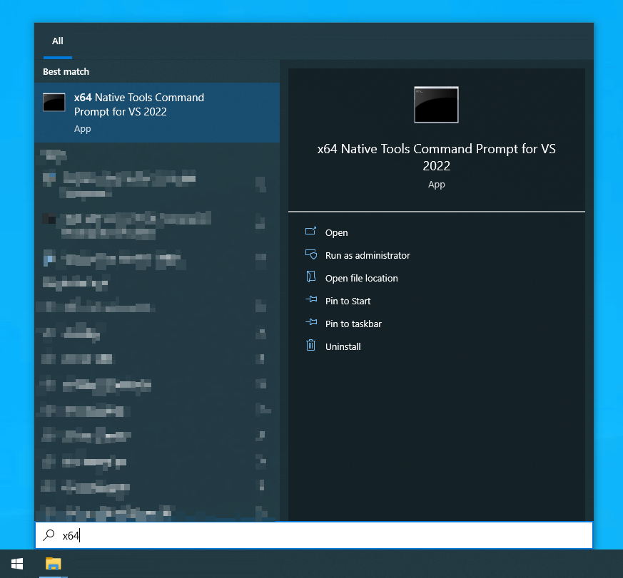
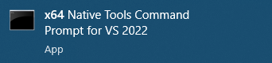
Programming
Compiling C files
Start “x64 Native Tools Command Prompt For VS”
Compile your code
cl.exe <filename.c>
Download the exercise files at https://go.tij.me/exercise1-good-luck.zip, easy mode cheat sheet at https://go.tij.me/exercise-cheatsheet.pdf

Slide 29

Becoming the APT
Exercise 1
Boot your virtual machine (64-bit Windows 10).
Download the exercise files at go.tij.me/exercise1-good-luck.zip.
Enable LSASS PPL by running enable-lsass-ppl.reg.
Install the vulnerable driver.
Reboot your virtual machine. #protip: create a snapshot you can revert to.
Find the driver device name using WinObj (sysinternals).
Compile exercise1.c and use it to open a handle to the driver.
25 min
sc.exe create dbutil_2_3 binPath= "c:\dbutil_2_3.sys" type= kernel start= auto sc.exe start dbutil_2_3
Download the exercise files at https://go.tij.me/exercise1-good-luck.zip, easy mode cheat sheet at https://go.tij.me/exercise-cheatsheet.pdf

Slide 30
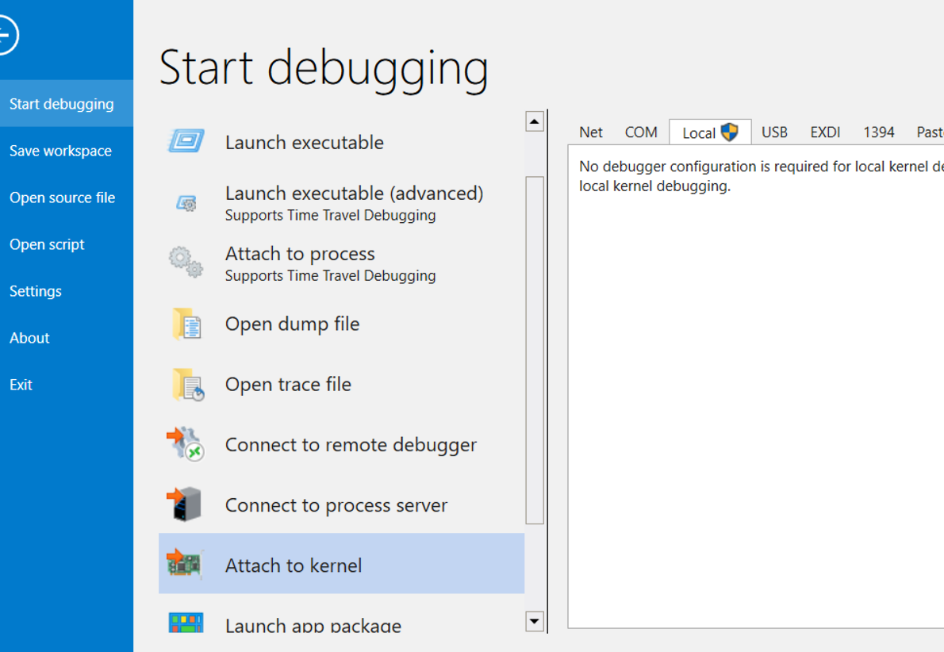
Debugging
Debugging the kernel using WinDBG
Enable debugging mode.
Reboot your virtual machine. #protip: create a snapshot you can revert to.
Start WinDBG (sysinternals) as administrator.
bcdedit.exe –debug on
Download the exercise files at https://go.tij.me/exercise1-good-luck.zip, easy mode cheat sheet at https://go.tij.me/exercise-cheatsheet.pdf

Slide 31
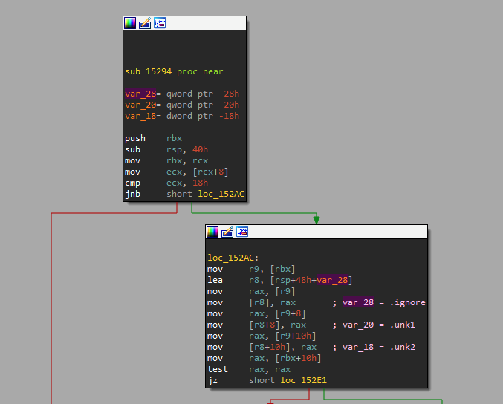
Debugging
Calling convention
Suppose we perform a memmove.
Then:
rcx = <dst> rdx = <src> r8 = <length> call memmove
memmove(void* dst, void* src, size_t len);
Download the exercise files at https://go.tij.me/exercise1-good-luck.zip, easy mode cheat sheet at https://go.tij.me/exercise-cheatsheet.pdf

Slide 32
Reversing kernel driver demo
REVERSING KERNEL DRIVER DEMO
Download the exercise files at https://go.tij.me/exercise1-good-luck.zip, easy mode cheat sheet at https://go.tij.me/exercise-cheatsheet.pdf

Slide 33
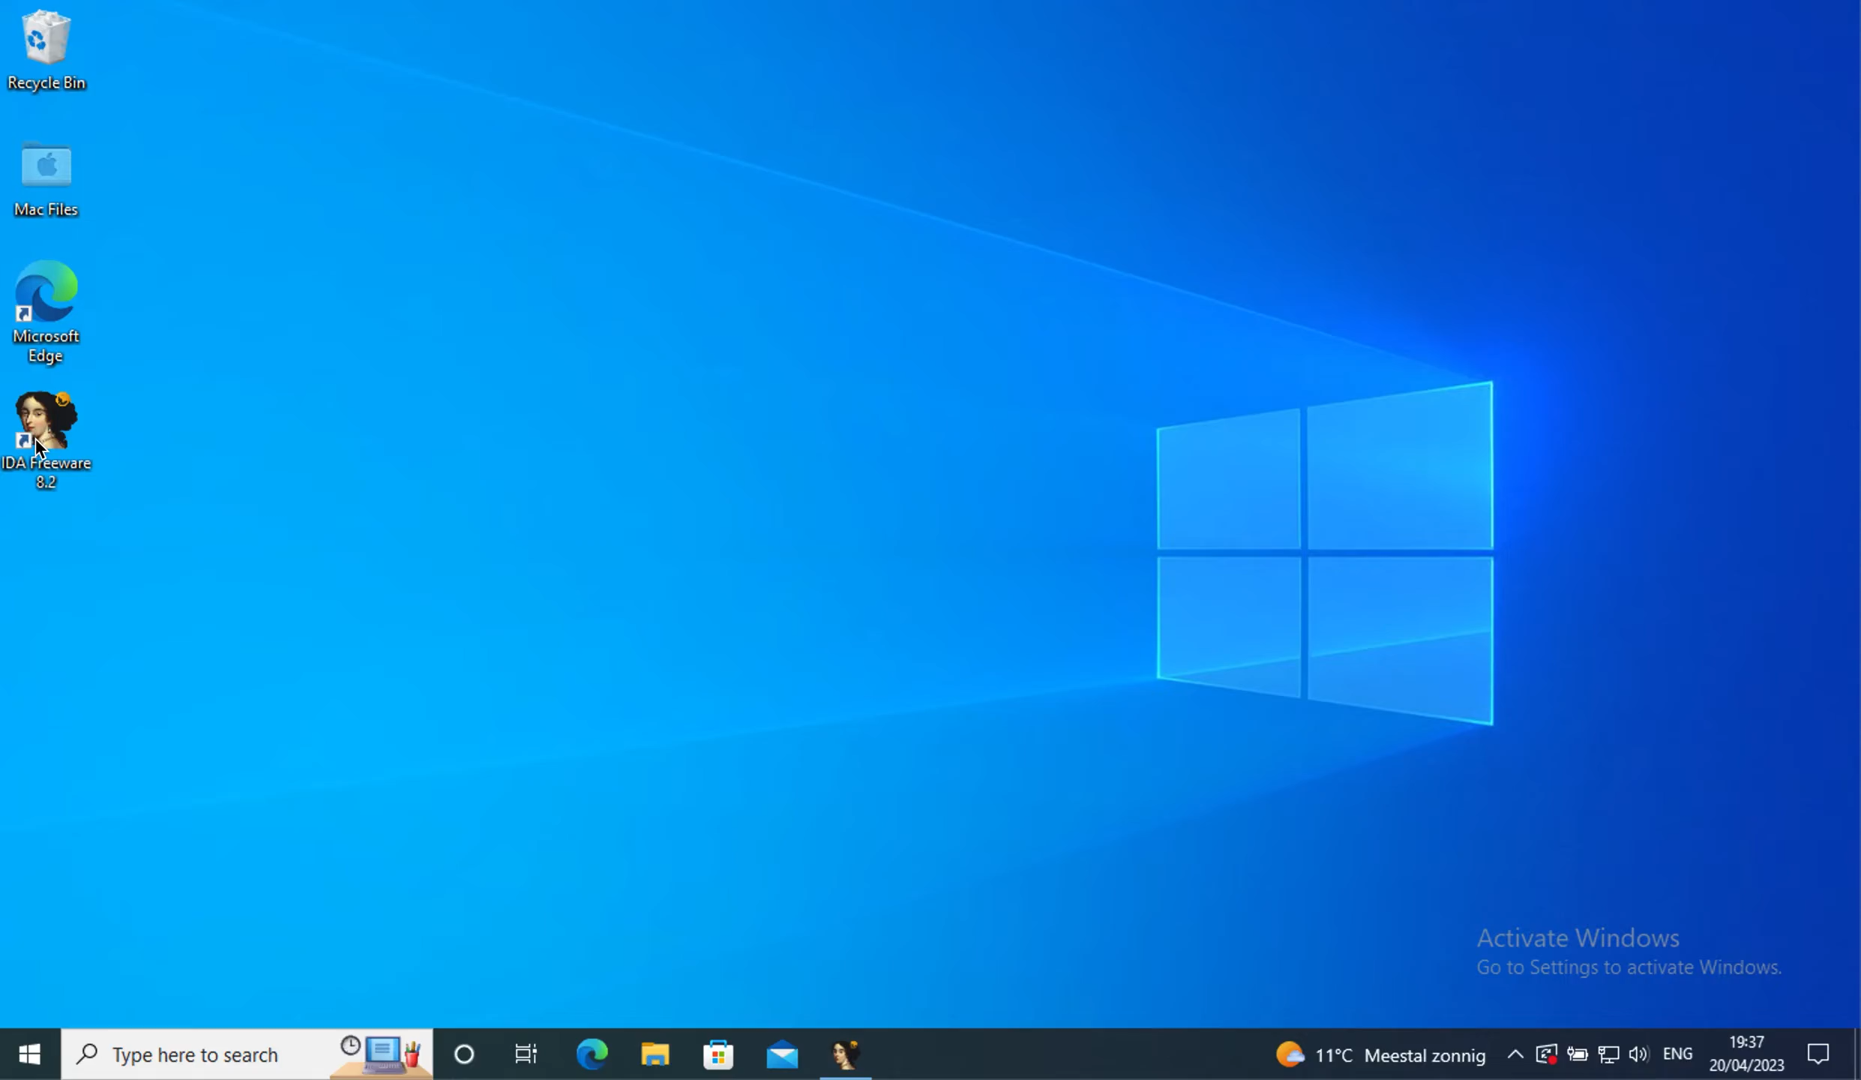
Download the exercise files at https://tij.me/exercise1-good-luck.zip

Slide 34
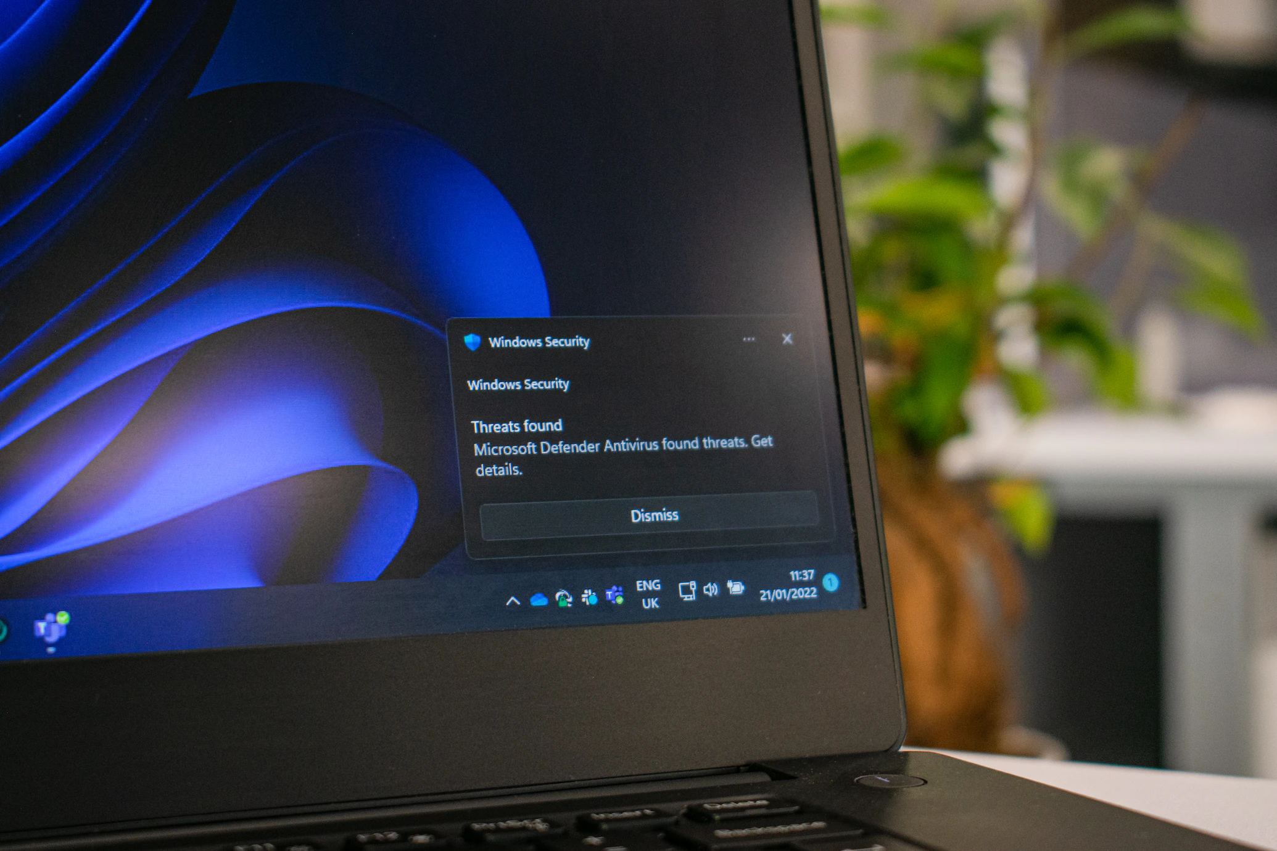
Becoming the APT
Exercise 2
Download the exercise file at go.tij.me/exercise2-you-can-do-it.c.
Use IDA Free to reverse the vulnerable driver. 2.1. Find the I/O control code (IOCTL) callback function. 2.2. Find the given vulnerable IOCTL numbers.
Adjust exercise2.c to interact with the IOCTL (legitimately).
45 min
Download the exercise files at https://go.tij.me/exercise2-you-can-do-it.c, easy mode cheat sheet at https://go.tij.me/exercise-cheatsheet.pdf

Slide 35
Windows Kernel 101
You can find most structs on vergiliusproject.com
EPROCESS (System)
KPROCESS PCB;
PVOID UniqueProcessId = 4;
LIST_ENTRY ActiveProcessLinks;
EX_FAST_REF Token;
FILE_OBJECT *ImageFilePointer;
UCHAR ImageFileName = “System”;
PS_PROTECTION Protection;
…
EPROCESS (LSASS)
KPROCESS PCB;
PVOID UniqueProcessId = 1279;
LIST_ENTRY ActiveProcessLinks;
EX_FAST_REF Token;
FILE_OBJECT *ImageFilePointer;
UCHAR ImageFileName = “Lsass.exe”;
PS_PROTECTION Protection;
…
PsInitialSystemProcess
…
Size: up to 2624 bytes Note: some fields have been omitted
Size: up to 2624 bytes Note: some fields have been omitted
…
Current process
…
Download the exercise files at https://go.tij.me/exercise2-you-can-do-it.c, easy mode cheat sheet at https://go.tij.me/exercise-cheatsheet.pdf
Notes:
IDA commented: https://go.tij.me/exercise2-ida-commented.zip

Slide 36
Windows Kernel 101
You can find most structs on vergiliusproject.com
typedef struct _LIST_ENTRY {
struct _LIST_ENTRY *Flink;
struct _LIST_ENTRY *Blink;
} LIST_ENTRY, *PLIST_ENTRY, PRLIST_ENTRY;
Download the exercise files at https://go.tij.me/exercise2-you-can-do-it.c, easy mode cheat sheet at https://go.tij.me/exercise-cheatsheet.pdf
Notes:
IDA commented: https://go.tij.me/exercise2-ida-commented.zip

Slide 37
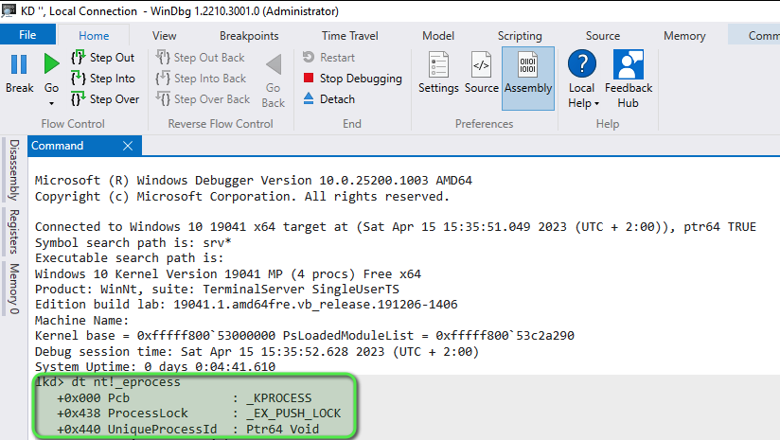
WINDBG 101
Download the exercise files at https://go.tij.me/exercise2-you-can-do-it.c, easy mode cheat sheet at https://go.tij.me/exercise-cheatsheet.pdf
Notes:
IDA commented: https://go.tij.me/exercise2-ida-commented.zip

Slide 38
Becoming the APT
Exercise 3
Download the exercise file at go.tij.me/exercise3-final-boss.c.
Understand the vulnerability.
Adjust exploit.c to exploit the vulnerability. 2.1. Find PsInitialSystemProcess. 2.2. Iterate over all other EPROCESS’s. 2.3. Identify which EPROCESS is LSASS. 2.4. Disable Protected Process Light on LSASS.
Use ProcDump to dump LSASS!
20 min + your own time
procdump -ma lsass.exe lsass.dmp
Download the exercise files at https://go.tij.me/exercise3-final-boss.c , easy mode cheat sheet at https://go.tij.me/exercise-cheatsheet.pdf
Notes:
IDA commented: https://go.tij.me/exercise2-ida-commented.zip

Slide 39
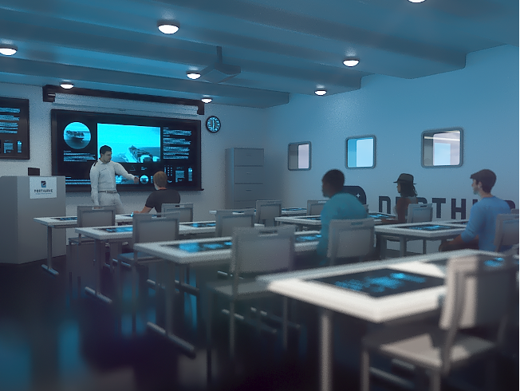
Recommended Literature
Low-Level Programming Igor Zhirkov
Windows Kernel Programming Pavel Yosifovich
Practical Reverse Engineering Bruce Dang
Windows Internals Pavel Yosifovich
© 2023 Northwave – All rights reserved – www.northwave-cybersecurity.com

Slide 40

© 2023 Northwave – All rights reserved – www.northwave-cybersecurity.com

